Slide 1
Lists and Hick’s Law
From https://www.pexels.com/photo/grayscale-photography-of-assorted-shirts-hanged-on-clothes-rack-1884584/

Slide 2
Learning Goals
Know how long it takes to find an item in a list
Understand why it is good to sort or group items
Lists and Hick’s Law

Slide 3
Finding an Item in an Unordered List
10s
9s
Find Denmark
8s
7s
6s
5s
4s
3s
2s
1s
0s
Lists and Hick’s Law

Slide 4
Finding an Item in an Unordered List
Russia
Ukraine
France
Spain
Sweden
Norway
Germany
Finland
Poland
Italy
United Kingdom
Romania
Belarus
Kazakhstan
Greece
Bulgaria
Iceland
Hungary
Portugal
Austria
Czechia
Serbia
Ireland
Lithuania
Latvia
Croatia
Bosnia and Herzegovina
Slovakia
Estonia
Denmark
Switzerland
Netherlands
Moldova
Belgium
Armenia
Albania
North Macedonia
Turkey
Slovenia
Montenegro
Kosovo
Cyprus
Azerbaijan
Luxembourg
Georgia
Andorra
Malta
Liechtenstein
10s
9s
Find Denmark
8s
7s
6s
5s
4s
3s
2s
1s
0s
Lists and Hick’s Law

Slide 5
Time complexity for unordered lists
We have a list with n items in an unknown order
Time obviously increases with n
What is the time complexity for an algorithm in Big O notation?
O(n)
Lists and Hick’s Law

Slide 6
Finding an Item in an Ordered List
10s
9s
Find Denmark
8s
7s
6s
5s
4s
3s
2s
1s
0s
Lists and Hick’s Law

Slide 7
Finding an Item in an Ordered List
Albania
Andorra
Armenia
Austria
Azerbaijan
Belarus
Belgium
Bosnia and Herzegovina
Bulgaria
Croatia
Cyprus
Czechia
Denmark
Estonia
Finland
France
Georgia
Germany
Greece
Hungary
Iceland
Ireland
Italy
Kazakhstan
Kosovo
Latvia
Liechtenstein
Lithuania
Luxembourg
Malta
Moldova
Montenegro
Netherlands
North Macedonia
Norway
Poland
Portugal
Romania
Russia
Serbia
Slovakia
Slovenia
Spain
Sweden
Switzerland
Turkey
Ukraine
United Kingdom
10s
9s
Find Denmark
8s
7s
6s
5s
4s
3s
2s
1s
0s
Lists and Hick’s Law

Slide 8
Time complexity for ordered lists
We have a list with n items in a known order
Time obviously increases with n
What is the time complexity for an algorithm in Big O notation?
O(log(n))
Lists and Hick’s Law

Slide 9
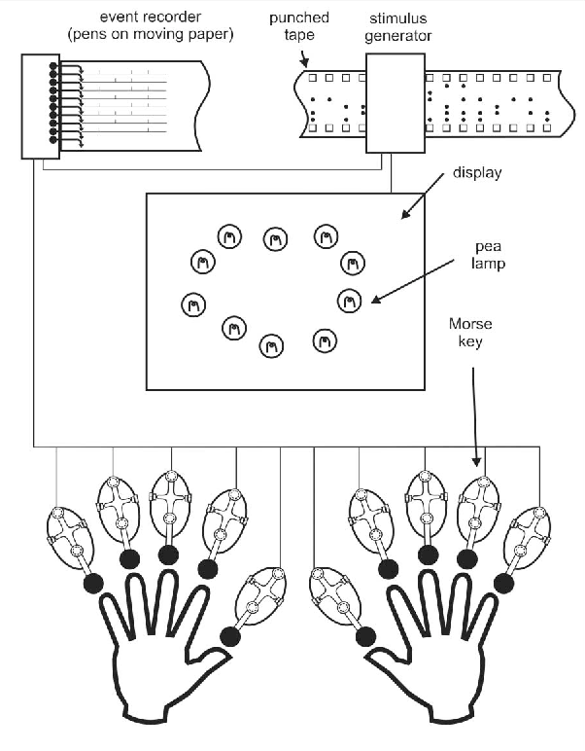
Hick’s Apparatus
From Seow, S. C. (2005). Information theoretic models of HCI: a comparison of the Hick-Hyman law and Fitts' law. Human-computer interaction, 20(3), 315-352.
Lists and Hick’s Law

Slide 10
Hick’s Law
Given n equally probable choices, the average reaction time T required to choose among the choices is approximately:
T = b*log₂(n + 1)
Common practical value: b=150 ms/bit
Hick’s Law is often used to motivate menu designns
In an unordered list, search time is linear
In an ordered list, search time becomes logarithmic
Lists and Hick’s Law

Slide 11
Combining Models
Lists and Hick’s Law

Slide 12
License
This file is licensed under the Creative Commons Attribution-Share Alike 4.0 (CC BY-SA) license:
https://creativecommons.org/licenses/by-sa/4.0
Attribution: Niels Henze
For more content see: https://hci-lecture.de

